Slide 1
4G Wireless Interworking LTE-WiMAX-EvDO-etc.
Charles Perkins
charliep@wichorus.com
UIUC, Oct. 27, 2010

Slide 2
Outline of presentation
Wireless networks today
Competing “industry” standards
IETF standards
Test case: how to use Mobile IP for LTE
Seamless Mobility
What’s next?

Slide 3








Session Continuity Among CDMA/WiMax/LTE is needed for 4G End Users
Mobile Broadband Services
Session Continuity
WiFi
Service core
ISP
internet
CDMA2000
Consistent User Experiences
RAN
CDMA MPC
SMS
WiMax
RAN
WiMax MPC
music
LTE
video
RAN
LTE MPC
mVoIP
Network
Cost Efficiency
Network Performance
Support
Tellabs 4G experience is an important asset to Convergence

Slide 4
Wireless today
www.bbc.co.uk/news/10569081: 5 billion cellphones
China has 815M, India has 670M
US is a distant third,
Russia next, with 147% penetration!
less than 1 billion ten years ago
Lots of bandwidth
People usually don’t lust after wired connectivity
but not enough
iPhone meltdown
Soon: vehicular networks, machine-machine
more pressure on address space

Slide 5
Wireless technology today
Internet access becoming very widespread
Disregard politically-motivated filtering?
IETF Beijing?!
100 Gbytes is a lot of storage
Wikipedia is 20 Gbytes?
World phone book is 10 Gbytes?
About a year's worth of music (.mp3, no repeats)
could already fit well within a cellphone!
3-D, stereo, barcodes, security, micropayments, etc.
General computing -- Android -- apps

Slide 6
http://YOU.wireless.net
With all of these technology advances, it “should” be straightforward to offer a fully functional mobile website
Why not??
People are not asking for this feature yet
Operators fear this; want to manage all such “services”
Private addresses make it difficult
Security story needs work
Two ideas worth investigating in order to get there
Better NAT
Seamless interworking

Slide 7
Wireless Industry Standards
GSM / GPRS / EDGE / HSPA+ [3GPP]
…. sssslllloooowwww … compared to 4G
CDMA / EVDO / HRPD [3GPP2]
Better, but …
WiFi [IEEE 802]
max range 150 miles ☺ ; max speed 220 Mb/sec
WiMAX [WimaxForum + IEEE 802]
max range 50 km; max speed 30Mb/sec, often < 10Mb/se
LTE [3GPP Release 8]
max speed 100 Mb/sec ; max range 1-3 km

Slide 8
IETF Standards
IPv*, DHCP*, routing protocols
Mobile IP, MIPv6, {P,H,F,DS}MIP, NEMO, MANET, “CMIP”
AAA (RADIUS/Diameter) is economically important
IPv6 is screwed in tightly enough to (inevitably) become economically important
Utilized properly, *MIP* should have greatly simplified 4G wireless infrastructure
But, it did not … why??
Project: identify technical barriers and resolve

Slide 9

Mobile IP protocol overview
Home Agent
correspondent node
Local Router
correspondent node
charliep@nokia.com
with binding
Routing Prefix from local Router Advertisement
Seamless Roaming: Mobile Node appears “always on” home network
Address autoconfiguration → care-of address
Binding Updates → home agent & correspondent nodes
(home address, care-of address, binding lifetime)

Slide 10
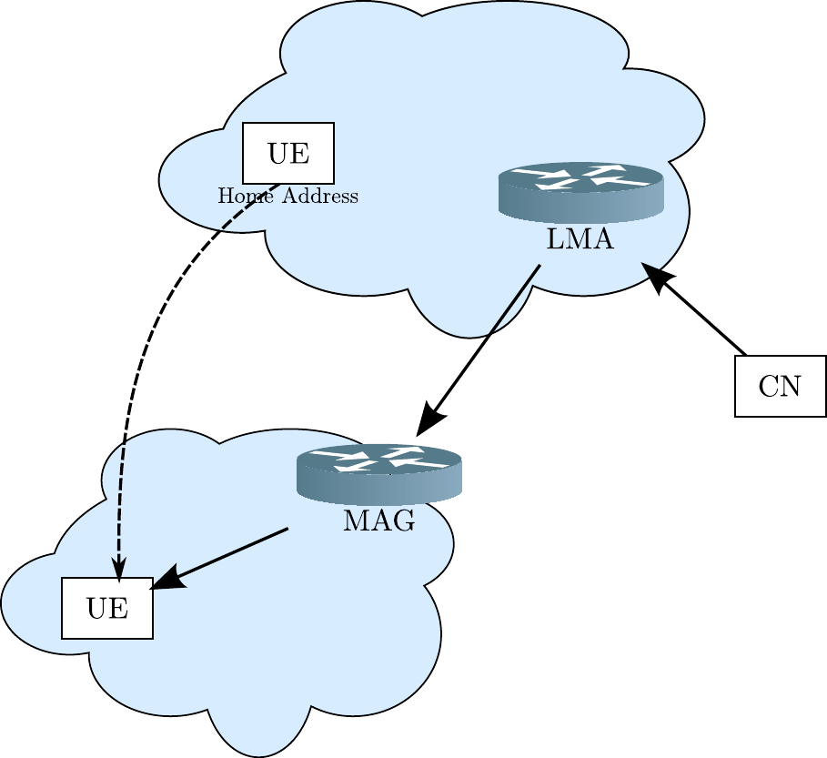
Proxy Mobile IP

Slide 11
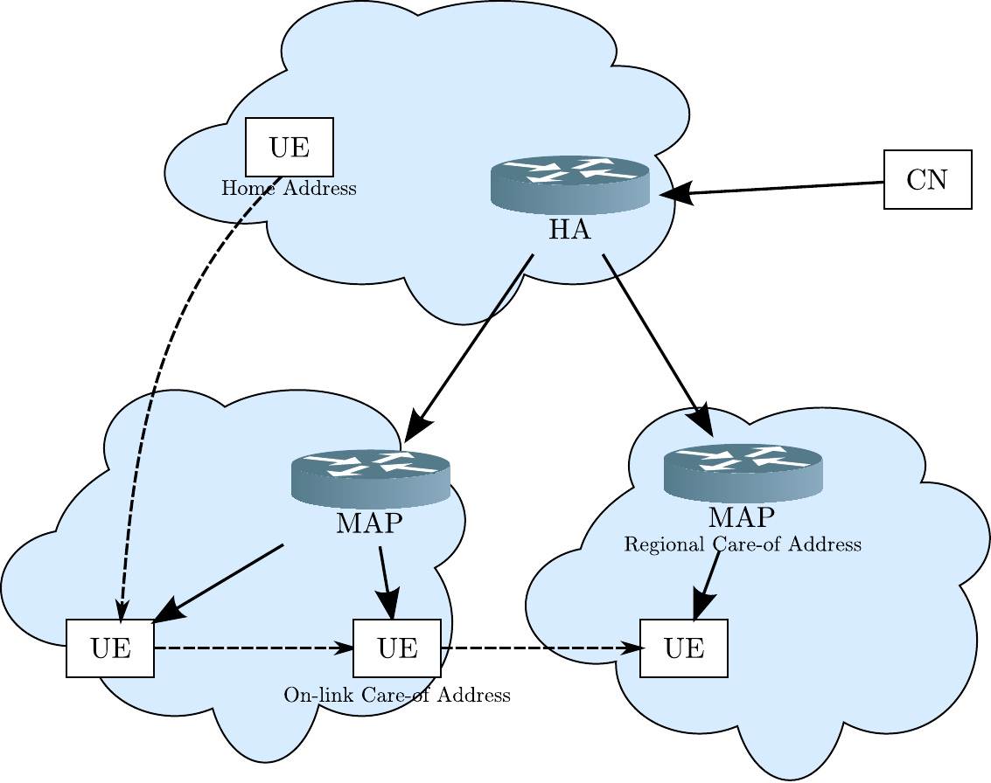
Hierarchical Mobile IP

Slide 12

FMIP (RFC 5568): Smooth/Fast/Seamless Handover
Smooth handover == low loss
Fast handover == low delay [30 ms?]
Can router pre-empt Duplicate Address Detection??
Seamless handover:
Fast [localized context transfer via HI and HAck]
Smooth [buffering]
NAR
PAR

Slide 13
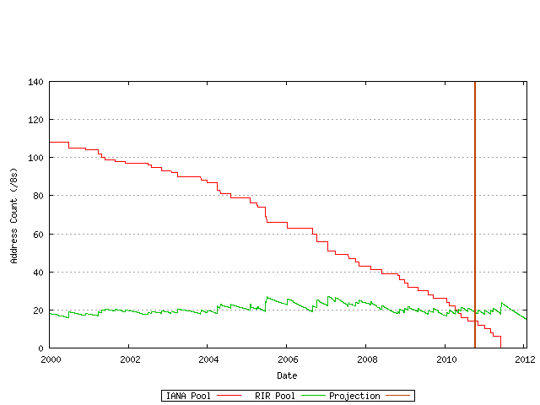
IPv4 address exhaustion
IANA runs out June 2011
RIRs run out in Jan. 2012
What’s next? eBay??

Slide 14
Movement towards IPv6
Verizon mandating IPv6 for all LTE end-devices
AT&T requiring IPv6 on all future infrastructure
Google enables IPv6 on all websites
Significantly – including YouTube
But, for search, you must be in the whitelist
Google “Google IPv6 Conference” for many papers
US Govt: everything to be IPv6-capable by 2014
Most major infrastructure vendors support IPv6 now
Remaining problem: some applications

Slide 15
IPv4 will dominate the internet for many years
How many? Who knows?! 10-15 years? Longer?
Even 15% for v6 would be huge, business-wise
Currently just above 0.1%, after big YouTube boost
Some people are much more optimistic
What to do in the meantime?
Specialized approaches like Skype or STUN
“Carrier-grade NAT”
What to do in the meantime?
Suffer

Slide 16
Today’s solution (for v4): NAT
NAT-based solutions have numerous problems
NAT traversal is quite problematic
Did you ever read your Skype agreement?
Numerous ALGs required
Some features just can’t be supported
Try to figure out Bit-torrent, for instance!!
IETF [behave] working group
For instance – check RFC 5382 for TCP reqs
Very unfriendly to mobility / Mobile IP

Slide 17
Business pitfalls of moving to IPv6 today
Practically all of the customers are using IPv4
So, business must serve IPv4 web accesses
Web presence is required 24 x 7 x 52 x …
This is not compatible with today’s NAT solutions, or today’s IPv6 solutions
Customers need to be able to contact business
Not the other way around!
Needed: “always on” NAT for v4→v6 translation
NOTE: NAT is needed for sure [ “evil” or not ]

Slide 18
Approaches for IPv4→ IPv6 translation
Almost any approach tautologically requires use of DNS
IVI: one IPv4 address needed per IPv6 address as in “NAT_64” picture [no demultiplexing]
IVI + DHCP, to enable time-based re-use of addresses
SIPNAT, enables simultaneous re-use of each IPv4 address for many different IPv6 addresses
Demultiplexing based on source IP address

Slide 19




SIPNAT: bidirectional NAT v4 ←→ v6 (uses DNS)
No changes to IPv6-only hosts or IPv4-only hosts
No dual-stack
No tunneling
Can delegate special domain to NAT box if desired
Modeled as a flow-management problem
source_IP NAT
IPv4 Internet
Internal
Network
Interface
Global net i/f
NAT’s IPv4 addresses
IPv6 Internal Network

Slide 20
Operation of SIPNAT: request phase…
Request IPv4
Address
DNS
DNS Query for v6host.org
2
1
source_IP NAT
IPv4 Internet
addr1
addr2
addr3
addr4
…
Note: DNS Query does not have source address of host
Internal
Network
Interface
Global network i/f

Slide 21
Operation of SIPNAT: DNS reply phase…
DNS
4
DNS Reply A record
3
NAT_addr4
Supply NAT_addr4
source_IP NAT
IPv4 Internet
addr1
addr2
addr3
addr4
…
For step 3, NAT receives the v4 address request and:
Overlays a new flow record for v6host at the v4 address NAT_addr4
Sets BIND_TIMEOUT
Awaits packet arrival at NAT_addr4 from v4-internet
Flow is not complete until source IPv4 addr. known
Internal
Network
Interface
Global network i/f

Slide 22
Operation of SIPNAT: flow completion
DNS
source_IP NAT
IPv4 Internet
addr1
5
addr2
addr3
addr4
…
BIND_TIMEOUT not yet expired
Packet arrival at NAT_addr4 from v4-internet
When packet arrives, resets timeout, adds source_v4
Flow can be completed with all four addresses and ports
Internal
Network
Interface
Global network i/f

Slide 23
Is it really like flow management?
Incoming < v4dev, sport, NATaddr, dport, TOS > → < v4mapped, sport, v6dev, dport, TOS >
Deep-packet inspection to determine ALG to use
Gradually move more functions to hardware?
Checksums
Pattern recognition
Have to search overlapping flow records per v4addr
Determine maximum degree of overlap?
This is what provides scalability for the solution

Slide 24
Unassisted mode failure: one source ←→ two dests
The system will fail if a specific source tries to access too many destinations
At each IPv4 address of the NAT, a source IP address (and, possibly, source port) identifies the flow
Can have one flow per source per NATv4 address, if lucky

Slide 25
Unassisted mode failure scenario B: all NATv4 addresses pending
The system will fail if there are too many new flow requests at about the same time
Have to keep the request “pending” until a packet arrives to provide the exact source IP address
Thus, each flow request temporarily (WAIT_TIME) consumes a NATv4 interface address
Since the DNS Request does not have the source IP address, the allocated flow will go to the source of the first packet to arrive that is not already deliverable
May need also to keep “pending” address open just a little longer to mitigate DoS

Slide 26
Seamless Handover - overview
It would be possible to use Mobile IP for handovers between 4G technologies – BUT:
FMIP does not provide for finding neighborhoods
LTE cannot yet allow for an external home agent
Handover context for each technology is wildly divergent

Slide 27
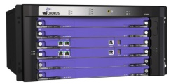
WiMAX network architecture -- SDO: WimaxForum
HA (opt.) Internet gw
ASN-gw for WiMAX mobility management
R3 for ASNgw ←→ HA
R6: tunnel to BS
R4 for ASNgw ←→ ASNgw
R8 for BS→BS handover
Internet
HA
ASN-gw
GRE
BS

Slide 28
CDMA network architecture -- SDO: 3GPP2
PDSN Internet gw (HA+FA)
Top-level mobility mgmt
PCF for each access n/w
A10/A11 ←→ PDSN
A8/A9 ←→ BS
A23 ←→ PCF
Internet
PDSN
PPP
PCF
BS

Slide 29
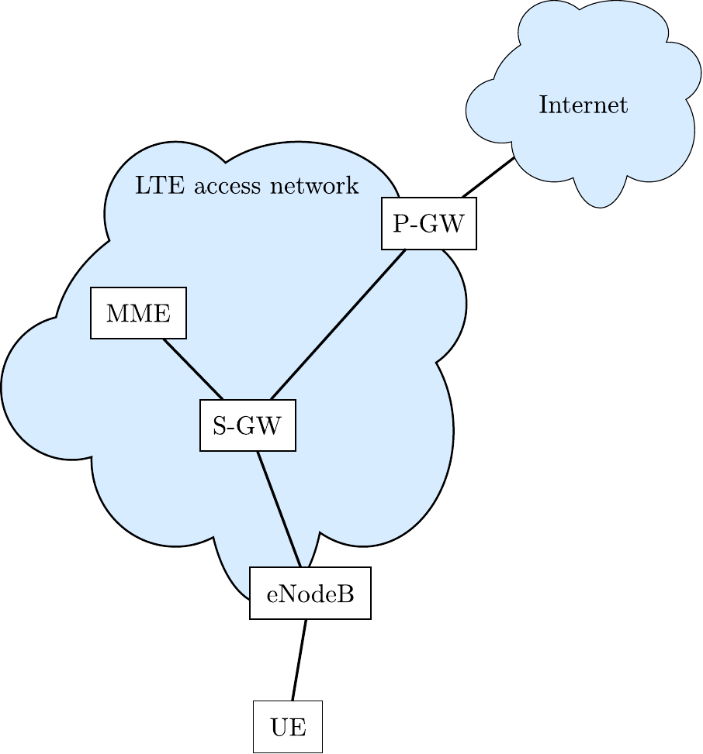
LTE architecture SDO: 3GPP [Release 8 & higher]

Slide 30
Mobile-IP based LTE project: Constraints & Goals
Constraints
Goals
eNodeB and MME shouldn’t be changed
Use existing LTE authentication procedures
Use existing policy interface via HA
Smooth and quick handovers
Identify Mobile IP features needed to support inferred LTE design goals
Present at IETF, publish

Slide 31
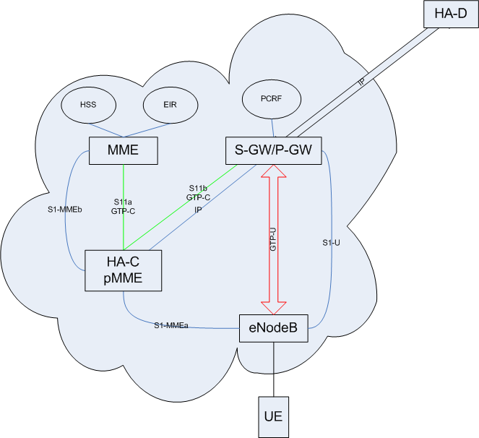
LTE Architecture needs changes to enable an external HA

Slide 32
Coming next week ----
VOTE!

Slide 33
Backup slides
Backup slides

Slide 34
1:1-IVI (1)
1:1 IVI statically reserves an IPv4 address for each IPv6 destination (IPv4-translatable address) which is to be made reachable to the global IPv4 Internet.
Each IPv4 address can only be used by a single IPv6 destination.
2.0.0.1:P1
Normal
DNS
H1
a.com
1.0.0.1:80
The IPv4
Internet
[Pref:1.0.0.1::]:80
2.0.0.2:P2
An IPv6
Network
(subset)
H2
xlate
2.0.0.3:P3
b.com
1.0.0.2:80
[Pref:1.0.0.2::]:80
H3
c.com
1.0.0.3:80
{1.0.0.1:80}→[Pref:1.0.0.1::]:80←a.com
{1.0.0.2:80}→[Pref:1.0.0.2::]:80←b.com
{1.0.0.3:80}→[Pref:1.0.0.3::]:80←c.com
[Pref:1.0.0.3::]:80

Slide 35
1:1-IVI (2)
For scenario 2 (also for scenario 1)
Stateless translation
Does not require DNS-ALG
Static address assignment
1-to-1 IPv4/IPv6 address mapping
Unmodified service port
2.0.0.1:P1
Normal
DNS
H1
a.com
1.0.0.1:80
The IPv4
Internet
[Pref:1.0.0.1::]:80
2.0.0.2:P2
An IPv6
Network
(subset)
H2
xlate
2.0.0.3:P3
b.com
1.0.0.2:80
[Pref:1.0.0.2::]:80
H3
{1.0.0.1:80}→[Pref:1.0.0.1::]:80←a.com
{1.0.0.2:80}→[Pref:1.0.0.2::]:80←b.com
{1.0.0.3:80}→[Pref:1.0.0.3::]:80←c.com
c.com
1.0.0.3:80
[Pref:1.0.0.3::]:80

Slide 36
1:1-IVI+DHCPv6 (1)
(1:1 IVI + DHCPv6) uses DHCPv6 to dynamically reserve a translatable IPv4 address for the IPv6 host. The reservation process updates the DNS with the allocated address so that the IPv6 destination becomes reachable.
At any one time, each IPv4 address can only be used by a single IPv6 destination, but over time the IPv4 address can be reused for other IPv6 destinations, depending on DHCP lifetime allocation policies.
2.0.0.1:P1
Dynamic
DNS
H1
a.com
1.0.0.1:80
The IPv4
Internet
[Pref:1.0.0.1::]:80
2.0.0.2:P2
An IPv6
Network
(subset)
H2
xlate
2.0.0.3:P3
b.com
1.0.0.1:80
[Pref:1.0.0.1::]:80
H3
DHCPv6
{1.0.0.1:80}→[Pref:1.0.0.1::]:80←a.com
{1.0.0.1:80}→[Pref:1.0.0.1::]:80←b.com
{1.0.0.1:80}→[Pref:1.0.0.1::]:80←c.com
c.com
1.0.0.1:80
[Pref:1.0.0.1::]:80

Slide 37
1:1-IVI+DHCPv6 (2)
For scenario 2 (also for scenario 1)
Stateless translation
Does not require DNS-ALG
Dynamic address assignment (may link to DNS)
1-to-1 IPv4/IPv6 address mapping
Unmodified service port
2.0.0.1:P1
Dynamic
DNS
H1
a.com
1.0.0.1:80
The IPv4
Internet
[Pref:1.0.0.1::]:80
2.0.0.2:P2
An IPv6
Network
(subset)
H2
xlate
2.0.0.3:P3
b.com
1.0.0.1:80
[Pref:1.0.0.1::]:80
H3
DHCPv6
{1.0.0.1:80}→[Pref:1.0.0.1::]:80←a.com
{1.0.0.1:80}→[Pref:1.0.0.1::]:80←b.com
{1.0.0.1:80}→[Pref:1.0.0.1::]:80←c.com
c.com
1.0.0.1:80
[Pref:1.0.0.1::]:80

Slide 38
Comparisons (1)
(1:1 IVI) is a good solution for destinations that serve many flows, and are each typically active serving one or more flows from the IPv4 Internet. In this case, there is little or no advantage to be gained by dynamic assignment.
(1:1 IVI+DHCP) is a good solution for destinations that may be inactive for extended periods of time, but are also likely to serve many flows during other extended periods of time.
Bi-Directional-NAT-PT shares some scalability properties with (1:1 IVI+DHCP)
(1:N IVI) is a solution which may be workable for situations where destinations host applications that are resilient and aware of port restrictions.
SIPNAT is a good solution for situations where there are a large number of IPv6 destinations, each of which serves a relatively low volume of flows (e.g, fewer than 100 distinct flows per hour).

Slide 39
Comparison criteria
Translator complexity
Stateless
DNS decoupled
Conserves IPv4 addresses
Application Port Transparency
Continuous service (vs. dynamic assignment)

Slide 40
Comparisons (2)
 | Stateless | Decoupled from DNS | Conserves IPv4 addresses | Application Port Transparency | Port-based Translation | Continuous service
1:1-IVI | yes | yes | no | yes | no | yes
1:1-IVI + DHCPv6 | yes | yes | yes | yes | no | no
SIPNAT | no | no | yes | yes | no | yes

Slide 41
Last words about IPv4→IPv6 NAT comparison
Supporting IPv4-initiated communication is crucial.
Compared (1:1 IVI), (1:1 IVI+DHCP) and (SIPNAT) solutions which support IPv4-initiated communication.
These approaches can be integrated to provide comprehensive support.
See draft-nat46compare-perkins-01.txt

Slide 42
More details about SIPNAT (research direction)
Unassisted SIPNAT has (rare) failure modes which can be eliminated by using additional techniques as explained
Guidance in choosing parameters is needed
How many IPv4 addresses?
How long BIND_TIMEOUT? WAIT_TIME?
Characterizing traffic is also important
HTTP traffic is “easy”, for instance
Random traffic doesn’t allow much help

Slide 43
Outline of presentation
To provide seamless interworking between LTE, WiMAX and CDMA2000 as well as WiFi
To minimize upgrades to major network components such as
PDSN, RNC, BS (for EvDO)
MME, SGW, PGW, eNodeB, HSS, PCC (for LTE)
ASN GW (for WiMAX)

Slide 44
Existing LTE specifications for Session Continuity
LTE specifies reference point S101 for pre-registration
UDP tunneling UE ←→ MME and UE ←→ “HSGW”
LTE specifies reference point S103 for avoiding packet loss during handover: S-GW → “HSGW”
ANDSF is recommended to find target eNodeBs

Slide 45
Existing HSPA specifications for Session Continuity
3GPP2 X.S0057 and X.S0058 for handover from WiMAX
Also C.S0086 for S101
Specifies new interface X1 for incoming handovers
HRPD SFF uses previously existing A23 interface for handover to HRPD AN
PDSN is already specified to act as Foreign Agent for MIP handovers with external home agent.

Slide 46
Existing WiMAX specifications for Session Continuity
Single Radio Interworking between Non-WiMAX and WiMAX Access Networks
Specifies reference point r9 to WiMAX SFF
Also NWG_3GPP_EPS_WiMAX_IWK_Specification_r13-1
Dual-radio
Annex to 23.402
TODO: insert drawing from spec.

