Slide 1
IEEE 802 Tutorial –
Heterogeneous Networking among the IEEE 802 Family:
Proposal for an OMNI Standard
Document Number:
IEEE 802.16-12-0465-00-Shet
Date Submitted:
2012-07-15
Source:
Harry Bims (Bims Laboratories, Inc.) <harrybims at me.com>
Max Riegel (Nokia Siemens Networks) <maximilian.riegel at nsn.com>
Roger Marks (Consensii LLC; WiMAX Forum) <roger at consensii.com>
Charlie Perkins (Futurewei) <charliep at computer.org>
Juan Carlos Zúñiga (InterDigital Communications, LLC) <JuanCarlos.Zuniga at InterDigital.com>
Re:
IEEE 802.16-12-0393-00-Gdoc (tutorial request form)
Base Contribution:
[none]
Purpose:
To provide the slides for IEEE 802 Tutorial #3 of 2012-07-16 in San Diego, California, USA.
Notice:
This document does not represent the agreed views of the IEEE 802.16 Working Group or any of its subgroups. It represents only the views of the participants listed in the “Source(s)” field above. It is offered as a basis for discussion. It is not binding on the contributor(s), who reserve(s) the right to add, amend or withdraw material contained herein.
Copyright Policy:
The contributor is familiar with the IEEE-SA Copyright Policy <http://standards.ieee.org/IPR/copyrightpolicy.html>.
Patent Policy:
The contributor is familiar with the IEEE-SA Patent Policy and Procedures:
<http://standards.ieee.org/guides/bylaws/sect6-7.html#6> and <http://standards.ieee.org/guides/opman/sect6.html#6.3>.Further information is located at <http://standards.ieee.org/board/pat/pat-material.html> and <http://standards.ieee.org/board/pat >.

Slide 2
IEEE 802 Tutorial – Heterogeneous Networking among the IEEE 802 Family: Proposal for an ONMI Standard 16 July 2012 San Diego, CA, USA Harry Bims (Bims Laboratories, Inc.) Max Riegel (Nokia Siemens Networks) Roger Marks (Consensii LLC; WiMAX Forum) Charlie Perkins (Futurewei) Juan Carlos Zúñiga (InterDigital Communications, LLC)

Slide 3
Abstract Proposals arising in the IEEE 802.16 Study Group on Heterogeneous Networks (HetNet Study Group) have suggested the development of a new IEEE 802 Open Mobile Network Interface (OMNI) standard to specify a common method of heterogeneous networking among all (or at least many) IEEE 802 access technologies for mobile broadband IP services. This tutorial highlights discussions within the Study Group and current plans, particularly in the context of related activities and specifications from other organizations, including IETF and the WiMAX Forum. The intent is to inform IEEE 802 participants about the current thoughts, directions and evolving plans, including considerations about the best home for eventual standardization work, and to encourage additional perspectives.

Slide 4
Status of IEEE 802.16’s HetNet Study Group (“Study Group on WirelessMAN radio interface in Heterogeneous Networks”) Harry Bims Bims Laboratories, Inc. see also: IEEE 802.16-12-0390-01-Gdoc IEEE 802.16-12-0351-00-Shet IEEE 802.16-12-0354-00-Shet IEEE 802.16-12-0392-00-Shet IEEE 802.16-12-0397-00-Shet

Slide 5
What exactly is a heterogeneous network?
There are at least four possible definitions . . . .

Slide 6
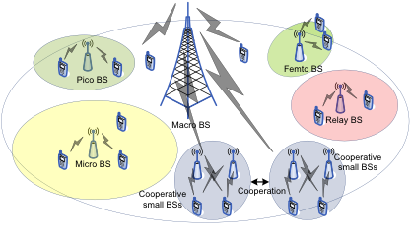
Multi-tier or Multi-Layer Heterogeneous Network (single RAT)

Slide 7
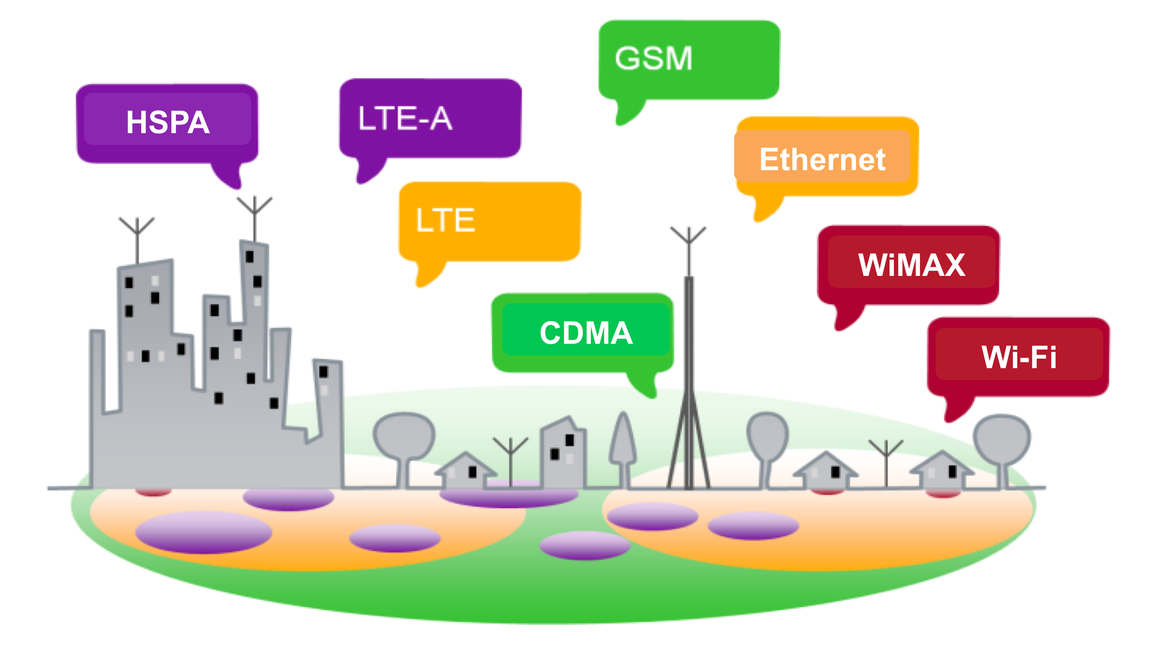
Multi-RAT Heterogeneous Network

Slide 8
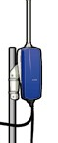
Multi-Service Heterogeneous Network
Fixed
DSL, Cable, FWA
Nomadic
Fixed WiMAX Wi-Fi
no session
continuity
Portable
Wi-Fi
session continuity
Mobile
Cellular
seamless handover

Slide 9
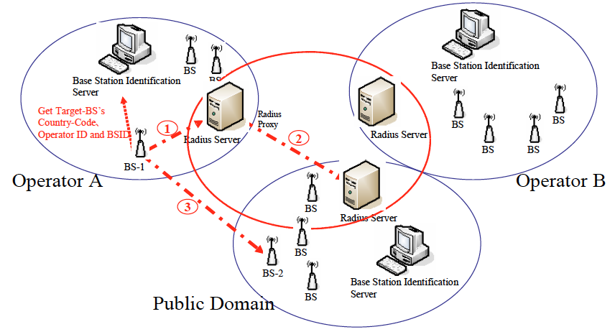
Multi-Operator Heterogeneous Network

Slide 10
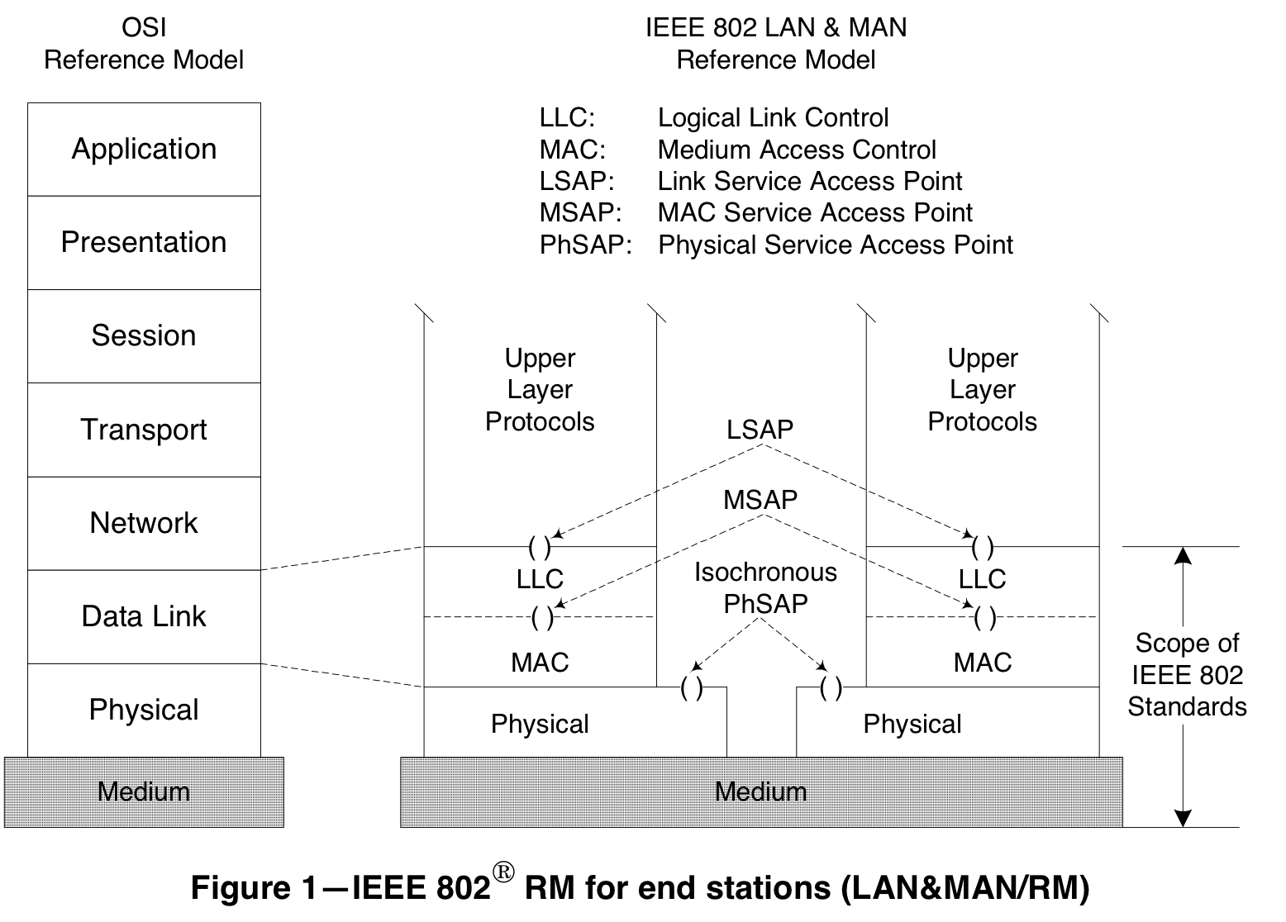
IEEE 802 Scope per IEEE Std 802-2001

Slide 11
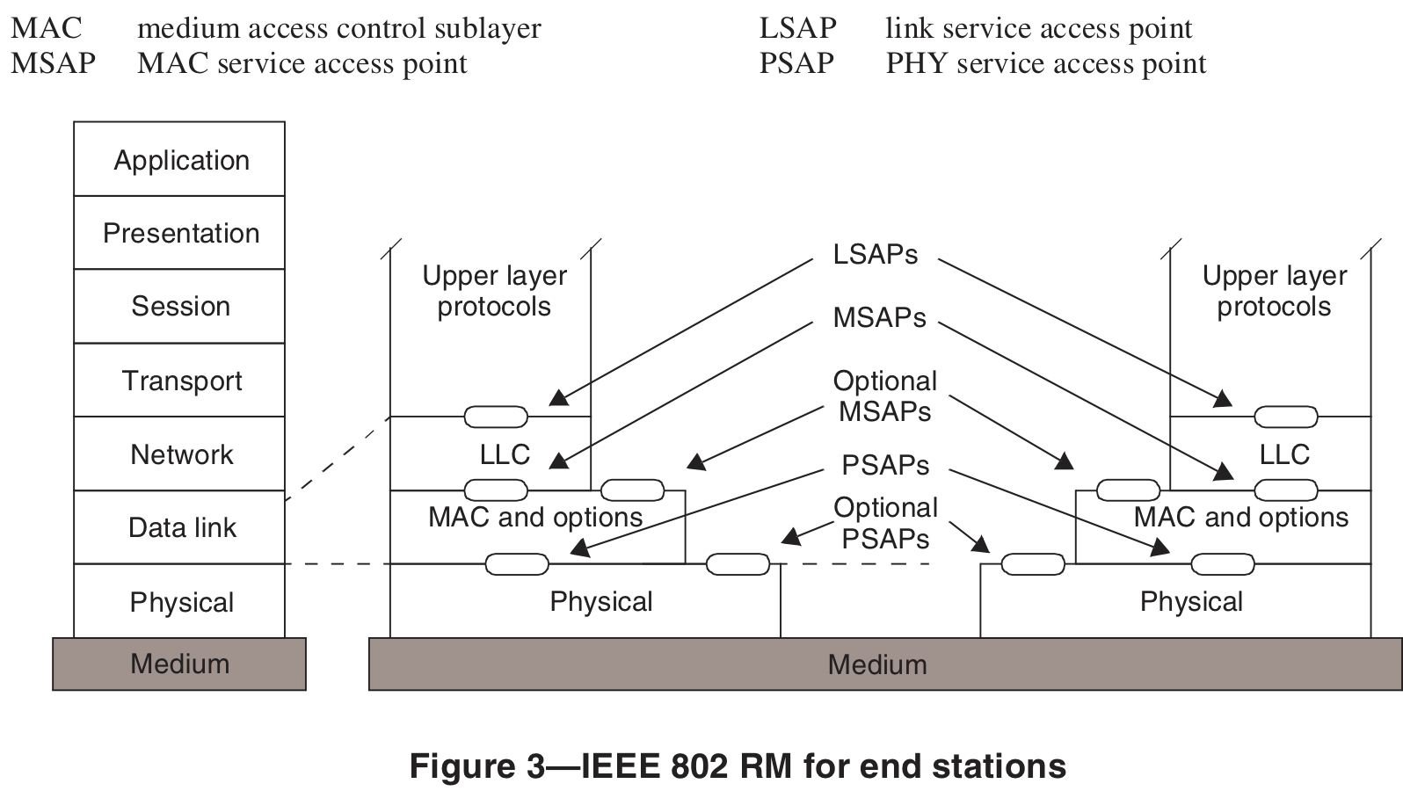
IEEE 802 Scope per IEEE P802-REV/D1.4 (June 2012)
But:
(1) “Scope of IEEE 802 standards” (plus related arrows and lines) stricken from P802-REV/D1.4 (June 2012)
(2) “The scope of 802 standards is not limited to only MAC and PHY standards.” (P802-REV/D1.3 and P802-REV/D1.4 )

Slide 12
HetNet Study Group Proposals
PAR proposals have been received for:
Multi-Tier: amendment to IEEE Std 802.16
Multi-RAT: Open Mobile Network Interface (OMNI)
Organizationally, belongs above 802.16
Architecturally, belongs above Layer 2

Slide 13
Estimated OMNI Project Timeline
DATE | Activity
March 16 | IEEE 802 initiated HetNet Study Group (SG)
May 14 - 17 | First HetNet Study Group session
July 16 | IEEE 802 OMNI Tutorial
July 16 - 19 | Second HetNet Study Group session Likely request to renew SG
September 17 - 21 | Third HetNet Study Group session Prepare OMNI PAR for submission
November 12 -16 | IEEE 802 can approve OMNI PAR
December 5 | IEEE-SA can initiate OMNI PAR

Slide 14
WiMAX Network Architecture Concepts for Heterogeneous Networking in IEEE802 Max Riegel Nokia Siemens Networks see also: IEEE 802.16-12-0354-00-Shet IEEE 802.16-12-0355-00-Shet

Slide 15
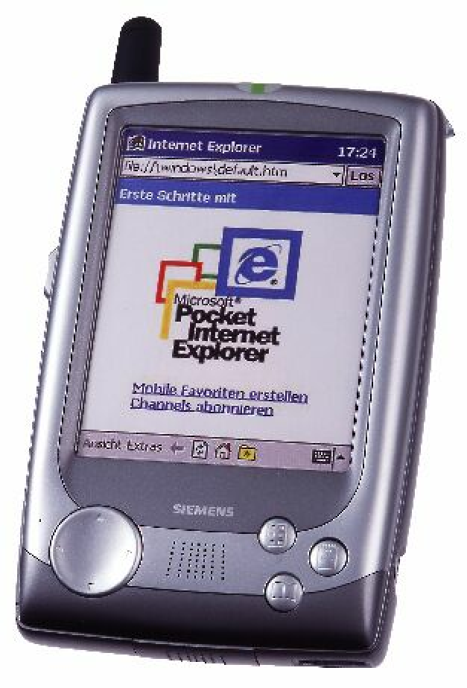
Heterogeneous Networking
“Getting access to the same content or applications by different networks.”
Can span:
“Multi-Tier” or “Multi-Layer” (various cell sizes)
“Multi-RAT” (various access technologies)
“Multi-Service” (fixed, nomadic, portable, mobile)
“Multi-Operator”
Network
A
Network
B
Network
C

Slide 16
Why Heterogeneous Networking?
Heterogeneous Networking is deployed for cost and performance reasons
Multi-Layer/Multi-Tier
Radio access network adaptation to the capacity needs
Multi-RAT
Better performance and efficiency by specialized radios
Multi-Service
Minimizing network complexity according to demand
Multi-Operator
Better network economics by shared use
Heterogeneous Networking is considered as the solution for the data explosion in the networks.

Slide 17
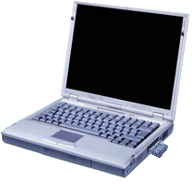
Network Partitioning for the Internet
USER
NAP
NSP
ASP
NSP
Internet
RAN
Core
Content
The Internet decouples the content and services from the access infrastructure
The access infrastructure itself is usually divided into a service control part (Core) and a service delivery part (RAN = Radio Access Network)
Independent operation of the different network parts is quite common for the Internet.

Slide 18
Multi- RAT/Service/Operator Networking
ASP
ASP
ASP
An NSP may have a special relationship with an ASP for value added services
Internet
An NSP may have a contract with another NSP
An NSP may have contracts with multiple NAPs
NSP
NSP
NSP
NAP
NAP
NAP
NAP
NAP
An NAP may have contracts with multiple NSPs
NAP: Network Access Provider
NSP: Network Service Provider ASP: Application Service Provider
USER
USER

Slide 19
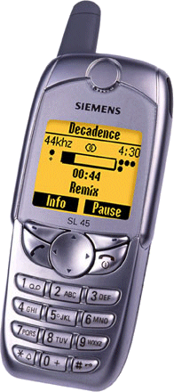
For Comparison: The legacy Mobile Network Structure
Services
Same partitioning exists also in legacy telecommunication networks
However:
Services are combined with control and radio access into a single operational entity
Terminals are tightly coupled to the operator to ensure proper use, i.e. prevent bypassing the operator’s policies and services
Value is generated by the services
Radio Access and Control are adjusted to the operator’s services
Complete standardization of services to enable interoperability and roaming
Control
Radio Access
Tight coupling (and subsidizing) of terminals
Subscriber

Slide 20
Mobile Network Architectures
Legacy Architecture
Mobile WiMAX Network Architecture
MNO ‘A’
MNO ‘B’
ASP
Services
Services
Internet
Core
Core
CSN
CSN
CSN
NSP
R5
RAN
RAN
R3
NAP
ASN
ASN
R2
R4
R1
Subscriber
Subscriber
USER
USER
USER
WiMAX Forum created the Mobile Network Architecture for the Internet

Slide 21
WiMAX Network Entities
CSN: Connectivity Serving Network Logical representation of the functions of a NSP, e.g.
Connectivity to the Internet and direct to ASPs
Authentication, authorization and accounting
IP address management
Mobility and roaming between ASNs
Policy & QoS management based on a SLA
ASN: Access Serving Network Logical representation of the functions of a NAP, e.g.
802.16 interface w/ network entry and handover
Radio Resource Management & admission control
L2 Session/mobility management
QoS and policy enforcement
Mobile Access Gateway (MAG)
Forwarding to selected CSN

Slide 22
WiMAX Reference Points
MS
ASN
CSN
R6
R1
RRM-C
RRM-S
R3
Pg/SM
Pg/SM
Pag. & Loc
Pag. & Loc
Config
Authorization
Authorization
PKM
PKM
Authentication
Authentication
QoS
QoS
QoS Ctrl
QoS Ctrl
HO
HO
Mob Mgmt
Mob Mgmt
DataPath
DataPath
DataPath
Encaps
Encaps
NRM Reference Points represent a bundle of protocols
Similar to a real IP network interface
The implementation of a particular protocols over a reference point is optional
If a particular protocol is present, it must conform to the WiMAX specification

Slide 23
Mobile WiMAX Network Reference Model
R2
MS
R1
BS
ASN
CSN
R6
ASN GW
CSN
R8
R3
R5
BS
R6
MS: Mobile Subscriber station
BS: Base Station
ASN: Access Serving Network
CSN: Connectivity Serving Network
R4
Another ASN
ASP Network
OR Internet
ASP Network
OR Internet
Mobile WiMAX Network Reference Point
Control and Data Path Control only
Different interoperable implementations of ASN and CSN possible. One single model of functional split of ASN into BS and ASN-GW standardized.

Slide 24
‘Heterogeneous’ Deployment of the Mobile WiMAX Architecture
NSP-A
NAP
CSN
AAA
ASP
PF
HA
BS
ASN
ASN
GW
NSP-B
Internet
MS
BS
CSN
AAA
MS
ASN
ASP
NSP-C
CSN
AAA
PF
Internet
HA

Slide 25
WiMAX Networking Summarized
Interoperability enforced via reference points without dictating how vendors implement edges of reference points
Introduces the notion of functional entities – which can be combined or decomposed by vendor and/or operator
No single physical ASN or CSN topology is mandated – allowing room for vendor / operator differentiation
Standardized decomposition of ASN into BS and ASN-GW
CSN is fully kept opaque; no aim for standardized implementations
Mobility is mainly achieved by ASN anchored MM (R6, R4)
R3 mobility (MIP) is used for path optimization, network sharing and wide-area nomadicity, but not for seamless handover.
AAA and Roaming is based on IETF EAP supporting any kind of ‘credentials’ (Password, Certificate, SIM & U-SIM)

Slide 26
Heterogeneous Networking in IEEE 802
IEEE 802 provides a variety of optimized PHYs and MACs for
fixed, nomadic, portable and mobile service
macro, micro, pico and femto cells + ‘wired’
However, IEEE 802 does not provide any specifications for inter-operator relations or higher layers of the Network-User-Interface.
Due to the variety of its User-Network Interfaces, heterogeneous networking seems to be a valuable topic for IEEE 802.

Slide 27
Mobile WiMAX Specification Framework
Application
Clients
Application
Server
IP Connectivity
R2
R5
BS
ASN-GW
AAA
AAA
Rating
Rating
Radio I/F
Radio I/F
DHCP
Clearing
X5
Clearing
DHCP
IEEE802.16
MAC
PHY
R1
IEEE802.16
MAC
PHY
R6
R3
X6
Financial Settlement
Financial Settlement
HA
HA
SS/MS
ASN
CSN
WRX
CSN
UNI
NNI
NNI
WiMAX provides ‘generic’ network specifications for:
User Network Interface (Authentication, IP-Configuration, Provisioning) on top of IEEE 802.16 radio specification
Network Network Interface (Network sharing, Roaming)

Slide 28
Leveraging WiMAX Specifications for heterogeneous networking in IEEE 802
While somewhat specific to IEEE 802.16, WiMAX network specifications can be leveraged to define generic network interfaces across all IEEE 802 technologies
User authentication and device provisioning
QoS and policy control
Network sharing and Roaming
(Mobility, when needed!)

Slide 29
References for Mobile WiMAX Networking
WiMAX Forum Specifications
WMF-T32-001-R020v01 - WiMAX Forum® Network Architecture - Architecture Tenets, Reference Model and Reference Points Base Specification - Release 2
http://www.wimaxforum.org/sites/wimaxforum.org/files/technical_document/2012/04/WMF-T32-001-R020v01_Network-Stage2-Base.pdf
WMF-T33-001-R020v01 - WiMAX Forum® Network Architecture - Detailed Protocols and Procedures, Base Specification - Release 2
http://www.wimaxforum.org/sites/wimaxforum.org/files/technical_document/2012/04/WMF-T33-001-R020v01_Network-Stage3-Base.pdf
Text Books with particular focus on WiMAX networking aspects
WiMAX Technology and Network Evolution
Kamran Etemad, Ming-Yee Lai
Deploying Mobile WiMAX
Max Riegel, Aik Chindapol, Dirk Kroeselberg

Slide 30
An IEEE 802 OmniRAN Roger Marks Consensii LLC & WiMAX Forum see also: IEEE 802.16-12-0350-00-Shet IEEE 802.16-12-0351-01-Shet IEEE 802.16-12-0352-01-Shet IEEE 802.16-12-0449-00-Shet IEEE 802.16-12-0450-00-Shet

Slide 31
“OmniRAN” Terminology
RAN: “Radio Access Network” (widely used term)
OMNI: “Open Mobile Network Interface”
Supports multiple RANs
“Mobile” can include fixed and nomadic elements
IEEE “Area Networks”, such as:
LAN: Local Area Network
MAN: Metropolitan Area Network
PAN: Personal Area Network
etc.
OmniRAN:
“Omni-Range Area Network”, based on OMNI

Slide 32
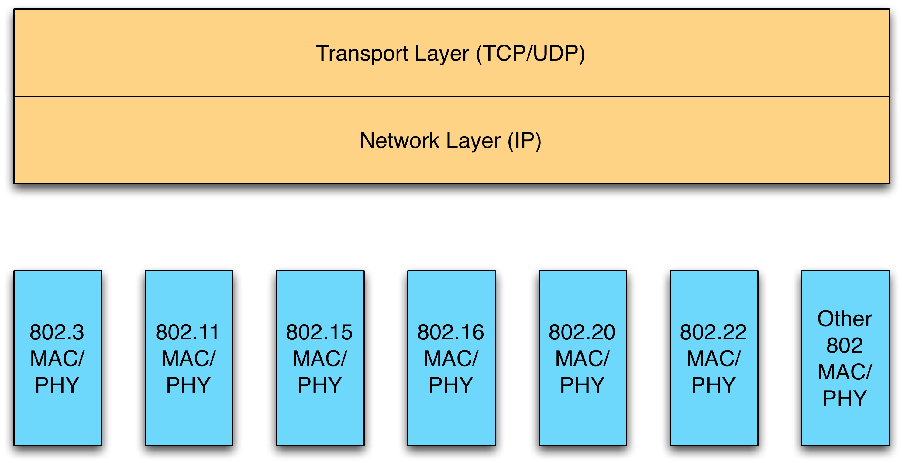
The Internet over IEEE 802
What’s wrong with this picture?

Slide 33
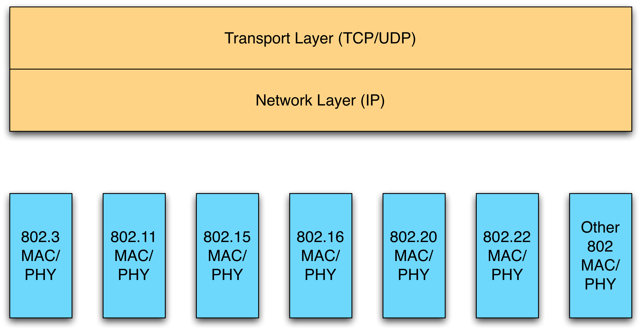
Mind the Gap
(1) Is this a family of standards? Or just roommates?
(2) Where are the functionalities needed in a commercial mobile network?

Slide 34
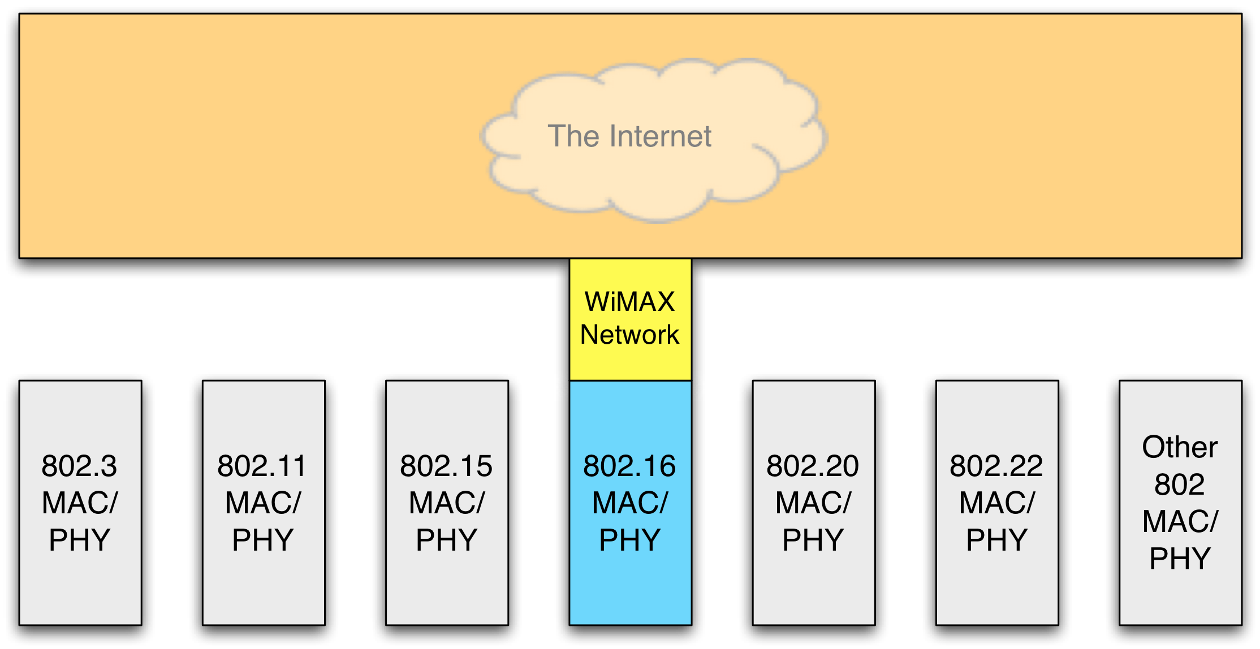
IEEE 802.16 in Commercial Service
WiMAX Network provides operator-required services to 802.16 devices: authentication, provisioning, mobility management, QoS management, roaming...

Slide 35
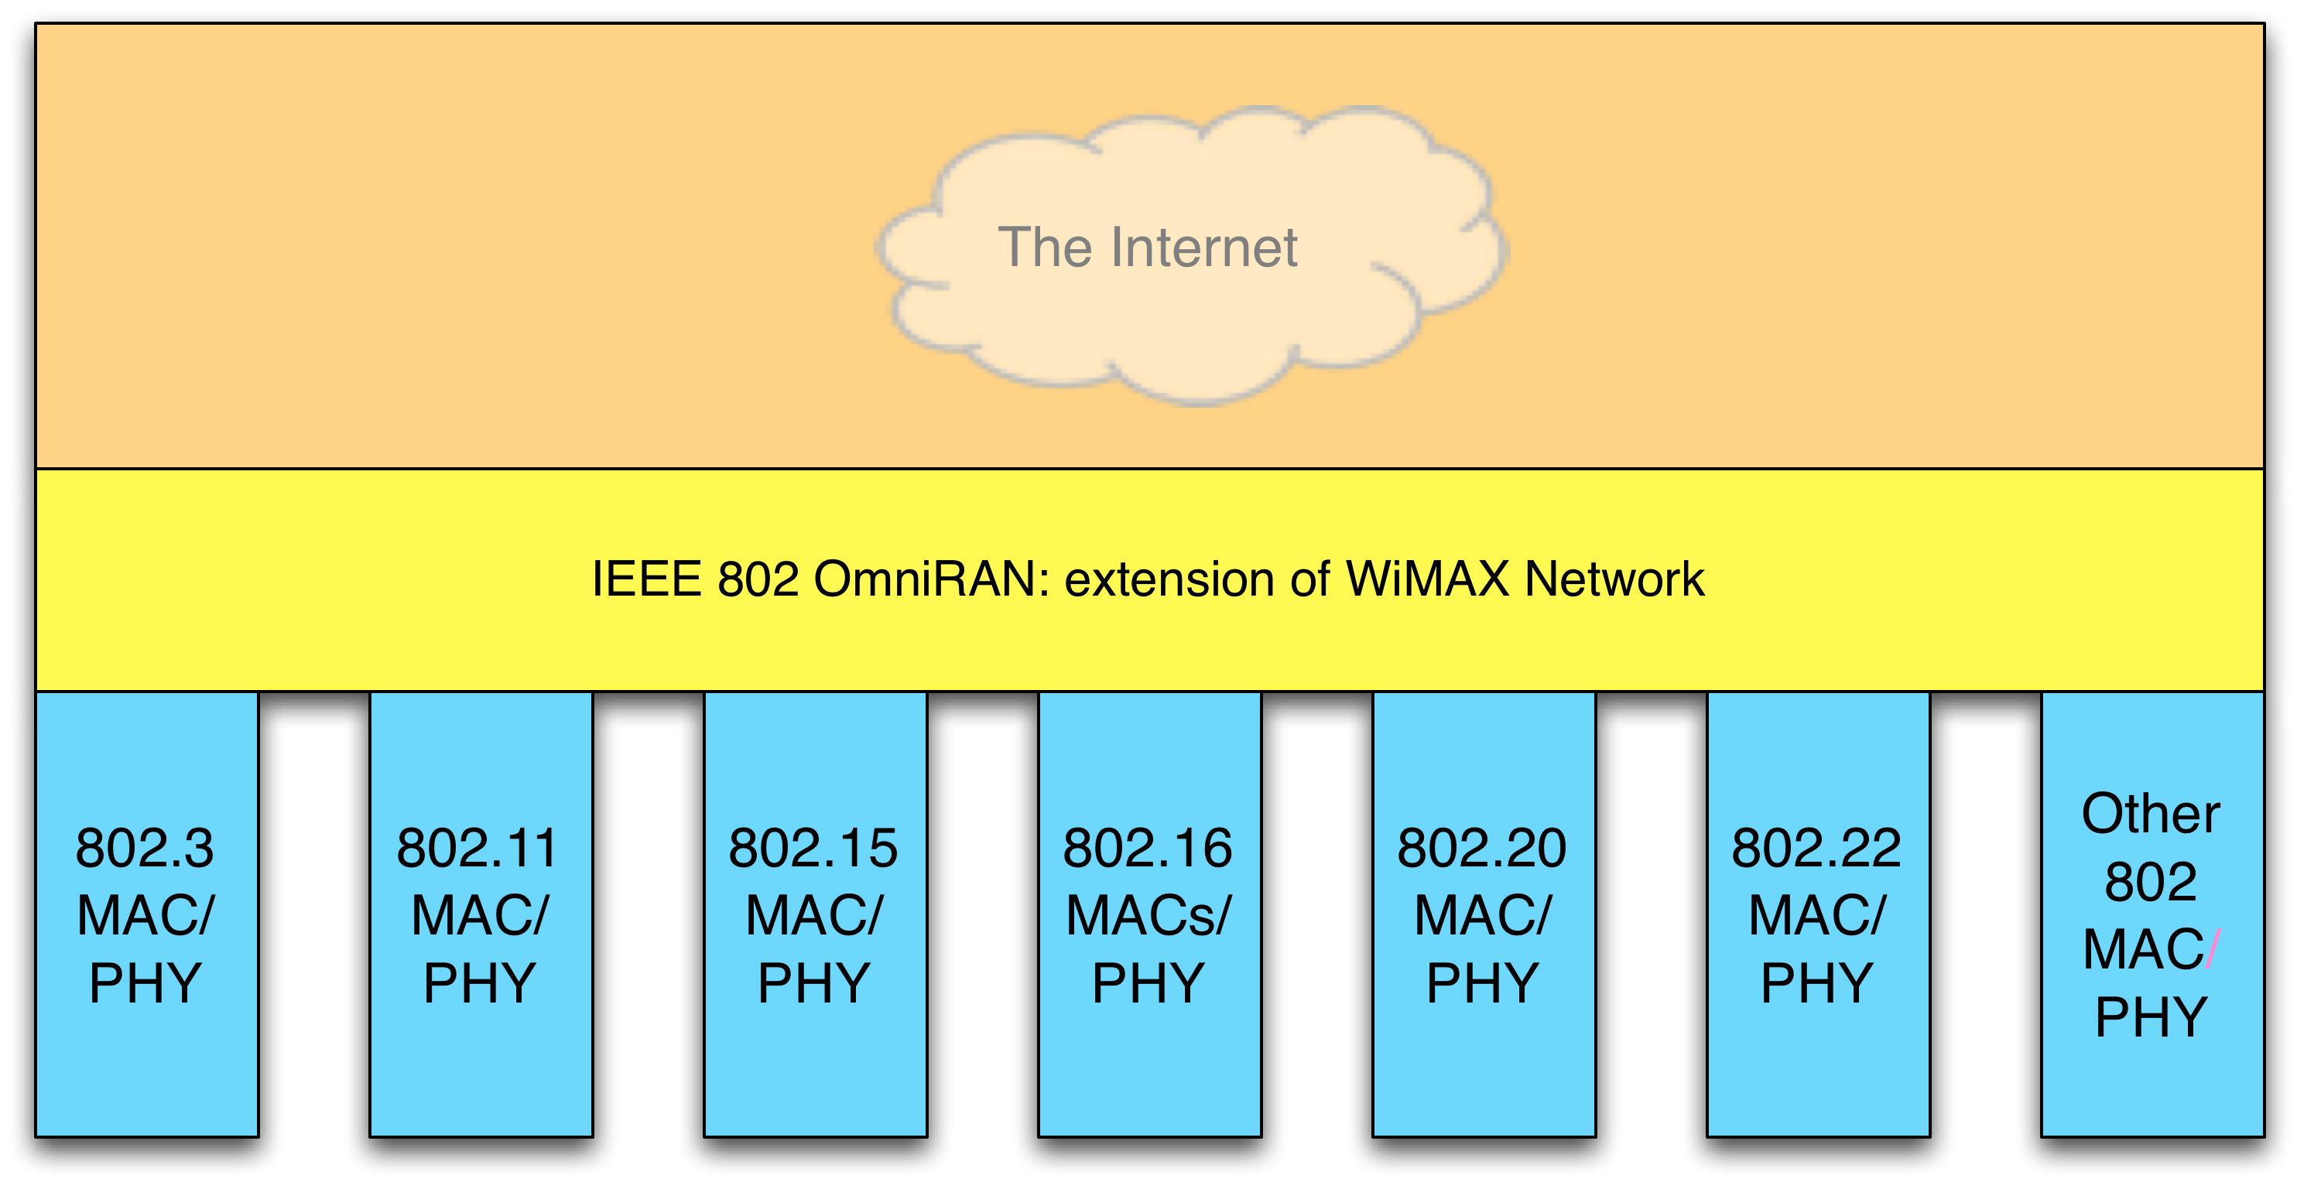
Closing the Gap: OmniRAN as a HetNet

Slide 36
OmniRAN Functionality Menu
Network Discovery and Selection
Authentication & Security
Provisioning
Accounting, Charging, and Settlement
Connection Management
QoS, Admission Control and Service Flow
Power Management
Interworking and Roaming
Radio Resource Management
Operation, Administration, Maintenance and Provisioning
Lawful Interception
Location Services
Emergency Telecommunications Service
VoIP

Slide 37
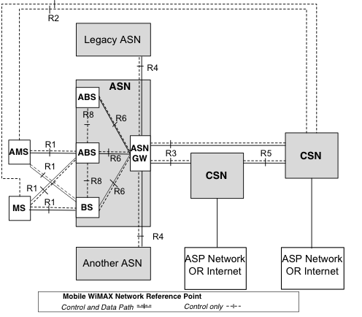
WiMAX Forum Network Architecture
MS, AMS | Mobile Station
BS, ABS | Base Station
ASN | Access Service Network
CSN | Connectivity Service Network
ASP | Application Service Provider
GW | Gateway
NAP | Network Access Provider
NSP | Network Service Provider
NAP
NSP

Slide 38
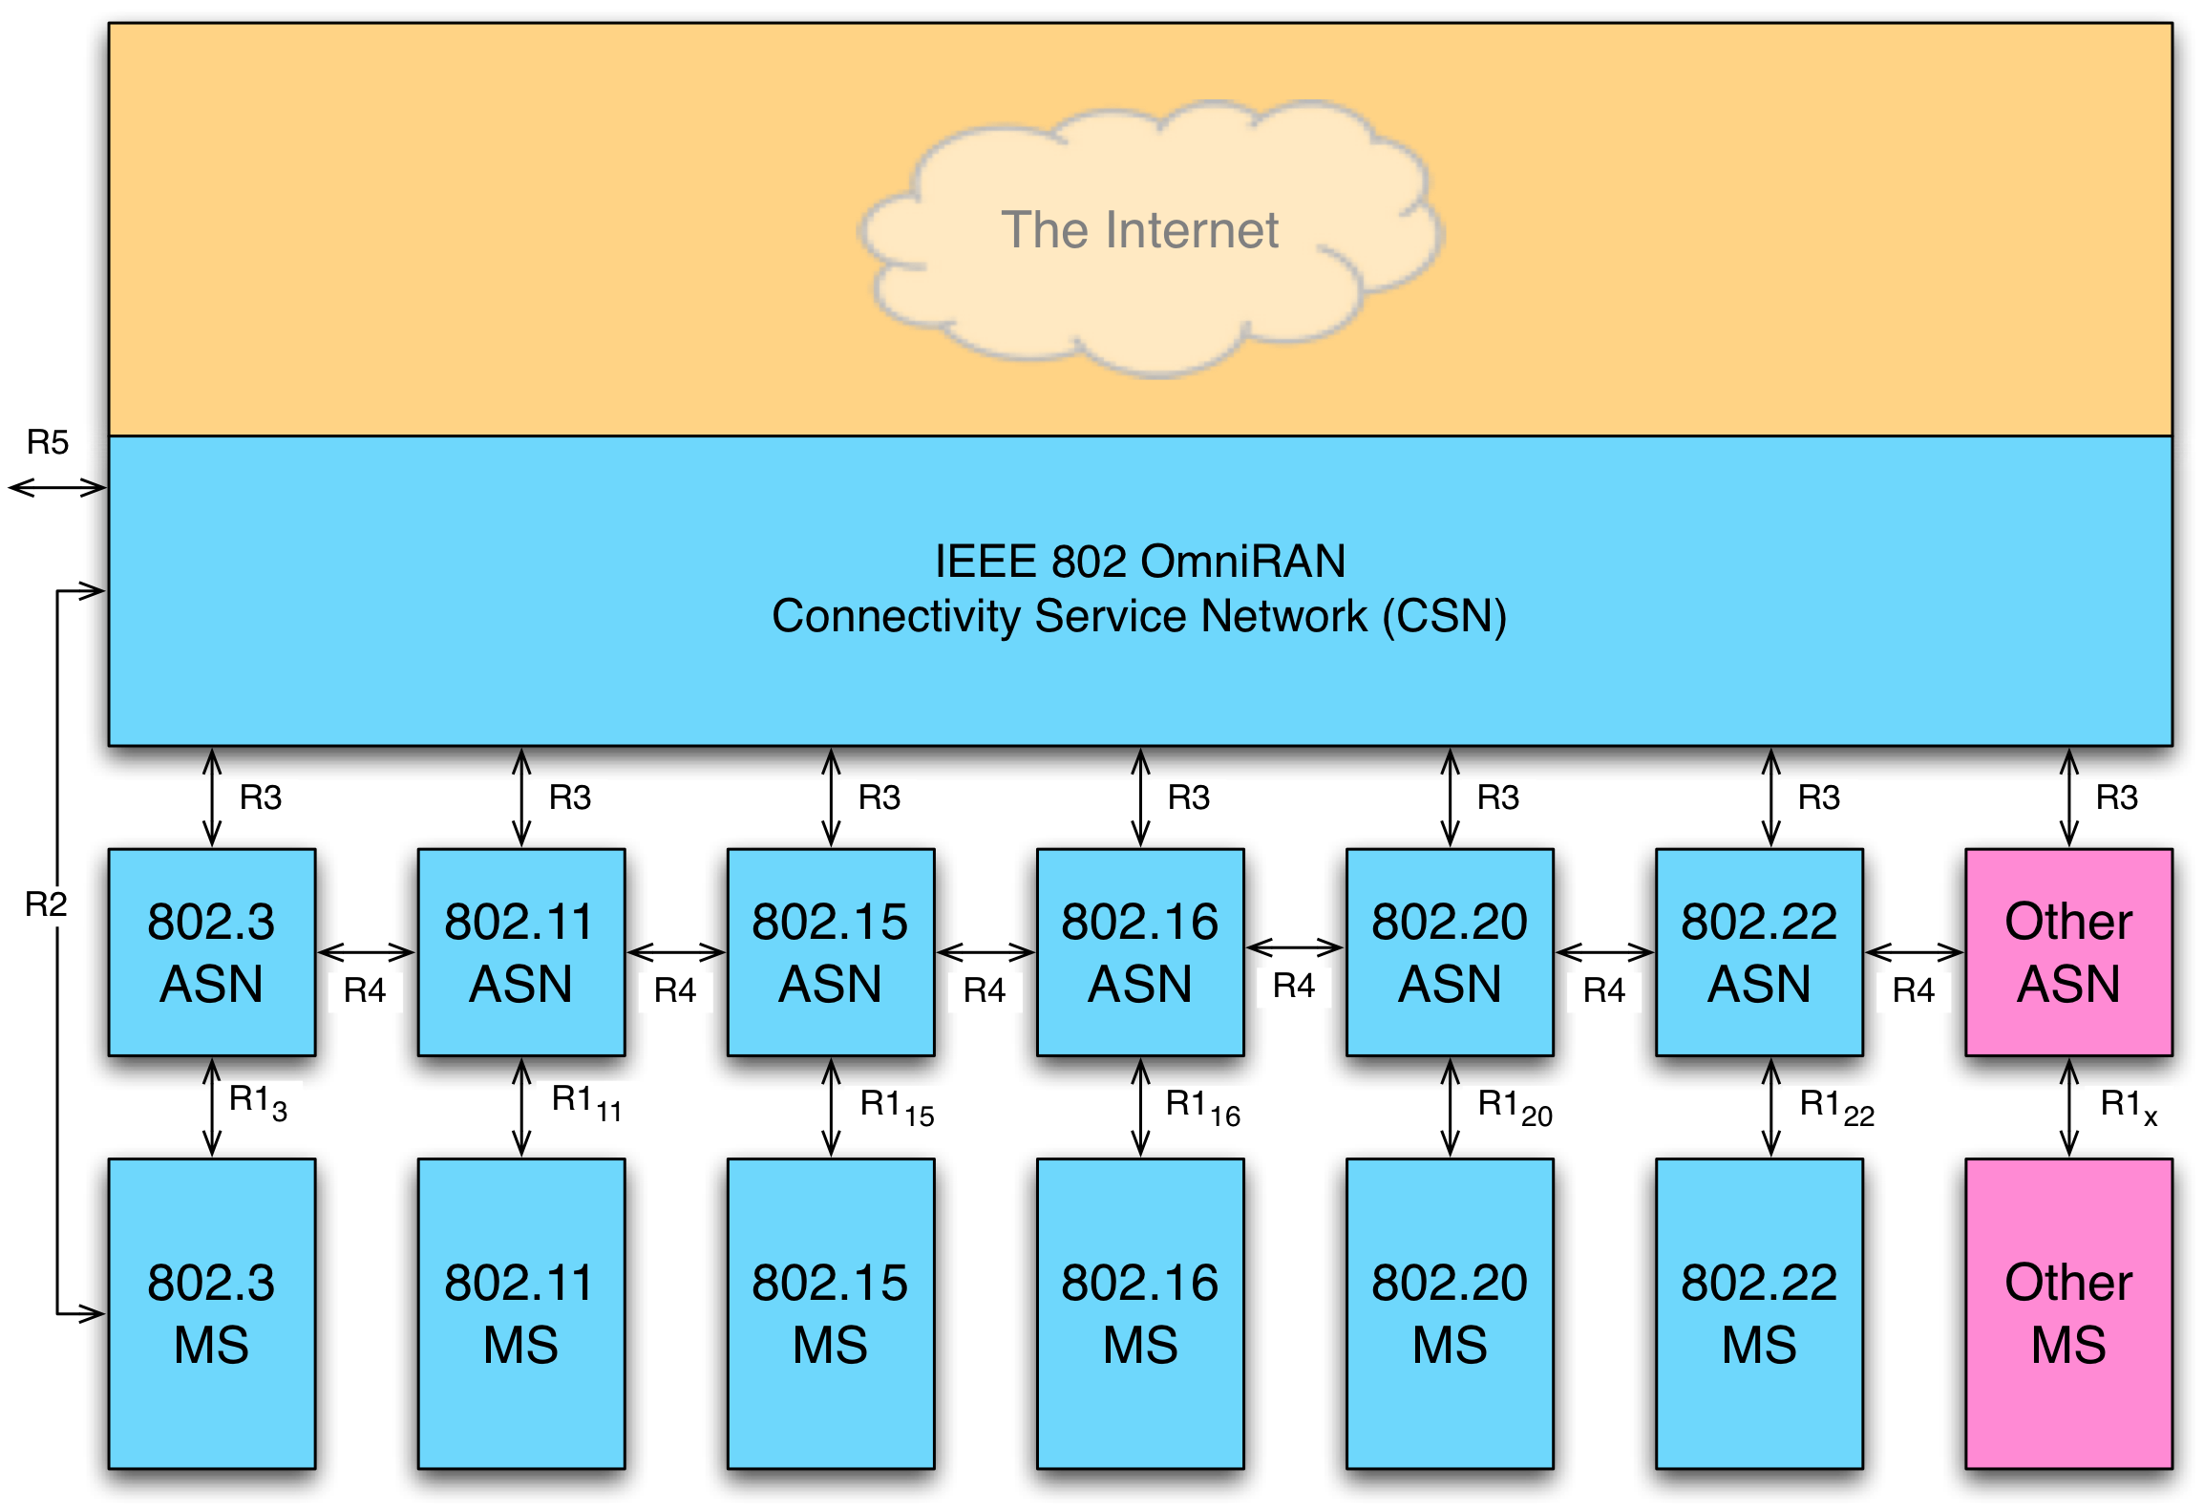
OmniRAN Architecture

Slide 39
Target Market for OmniRAN
Operators (including WiMAX Operators; wireless ISPs; current wireline & utility operators; etc.) with focus on:
IP connectivity
a lean, low-complexity network
mobility functions, such as authentication, provisioning, handover, billing and roaming (even in fixed deployments)
possible heterogeneous deployments
could support homogeneous as well

Slide 40
Segment Conclusions
IEEE 802 OmniRAN can close the gap and tie 802 devices into an family of standards within a heterogeneous IP network.
WiMAX Forum network specifications have been developed and optimized for the required functionality.
OmniRAN network architecture and functionality can be based on the WiMAX Forum network specifications.
Core functionality of the OmniRAN would be as a Connectivity Service Network (CSN).
Unified network interfaces to ASN
ASNs customized for each interface technology.
Speaker’s recommendation: Standardization will be most efficient in a new 802 Working Group.

Slide 41
IETF Baseline Mobility and Architectures Charlie Perkins Futurewei

Slide 42
IETF Advanced Mobility Juan Carlos Zúñiga InterDigital Communications, LLC

Slide 43
IP Flow Mobility (IFOM)

Slide 44
IP Flow Mobility (IFOM)
Seamless and selective switching of a single application from one access network to another, leaving other IP Flows untouched
Several standardization efforts (IETF NETEXT, 3GPP SA2 SAMOG, MAPCON, MAPIM, NBIFOM)
Enables new tiered-services by applying user-specific policies and tariffs
Network-based IP flow mobility (NB-IFOM) (PMIP/GTP-based) and client-based (DSMIP-based) solutions exist

Slide 45









IP Flow Mobility
Internet
Traffic can be steered from one radio access network to another to achieve:
Offloading
Service differentiation
Security
Seamless inter-RAT handover / session continuity
VoD
VoIP
P2P
IM
Core Network IPv6
P-GW / LMA
GTP / PMIPv6 tunnels
Network Manager
S-GW / MAG 2
S-GW / MAG 1
3G / LTE
WiFi
VoIP
Video
Video

Slide 46
Logical Interface – Data Plane
Allows hiding L2/L1 changes to IP stack and maintaining session bindings active
Permits forwarding traffic to different access networks regardless of the original IP address assignment
TCP/UDP
Session to IP address binding
IP
IP to logical interface binding
Logical Interface
Logical to physical interface binding
L2 (IF#1)
L2 (IF#2)
L2 (IF#n)
…
L1
L1
L1

Slide 47
802.21 MIHS – Control Plane
Provides predictive signaling that can proactively trigger handovers or flow mobility and hence enhance QoE (ES)
Allows a better control of lower layers to enforce Operator and User’s policies (CS)
Provides information about available access networks (IS)
MIH User
(MIP, Policy Control, Conn Mngr)
MIH SAP (API)
MIHF
MIH Link SAP (API)
L2 (IF#1)
L2 (IF#2)
L2 (IF#n)
…
L1
L1
L1

Slide 48
IETF Dynamic / Distributed Mobility Management (DMM)

Slide 49
DMM Problem Statement
Current IP mobility approaches (MIP, PMIP, GTP, etc) rely on a central anchor point
Issues:
Sub-optimal routing to edge content (CDN)
Reliability
Scalability
Lack of granularity
Mobility offered on a per-mobile basis
Signaling overhead
Heterogeneous networks (small cells, integrated BS/AP, etc)

Slide 50
Use Case 1: Low Mobility User
Always-on mobility support is quite a big overhead here
Start with mobility support off,
enable it on demand
(if needed)
User seldom moves (if at all)

Slide 51
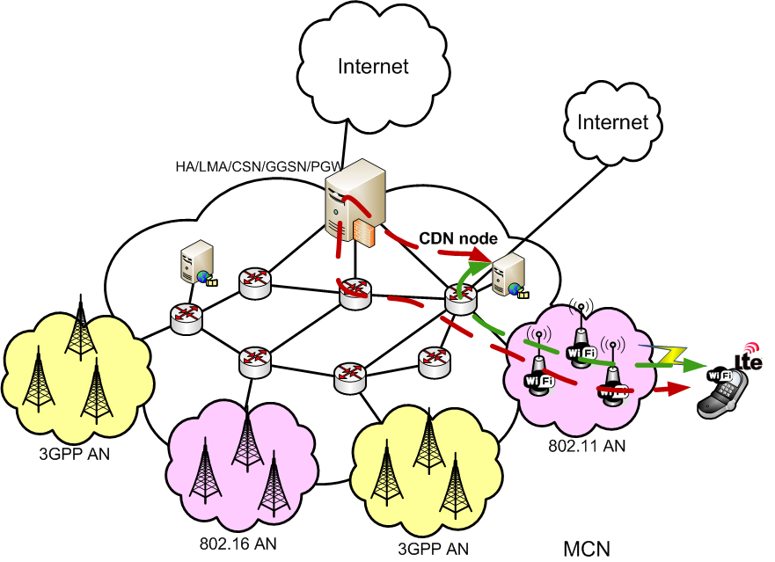
Use Case 2: Local Content/Breakout
User is accessing content locally available or a local breakout to the Internet is available (LIPA/SIPTO)
Centralized anchoring is sub-optimal
Push data plane mobility anchors to the edge of the network

Slide 52

Use Case 3: Mobility-enabled Apps
Application is able to handle and survive an IP address change
Current architectures provide sufficient support w/o mobility
IPa
Do not trigger mobility management (signaling and state) unless required
IPd
IPb
IPc

Slide 53
Dynamic/Distributed Mobility Management (DMM) – IETF Solutions
Pushing mobility anchors to the edge of the network
Distributed Mobility Management
Mobility should only be enabled when it is actually needed
Applications that cannot survive an IP address change
Only needed if the user really moves
Dynamic Mobility Management
People usually refer to both concepts as DMM
Network-based and client-based proposals exist

Slide 54
DMM (1)
When a Mobile Node attaches to an Access Router (AR) it gets an IP address which is topologically anchored at the AR
MN starts communications with the configured address
The AR acts as standard IP router
MN can send/receive traffic with no packet encapsulation
CN
AR1
AR2
AR3
IP::ADDR1
MN

Slide 55
Client-based DMM (2a)
Upon changing point of attachment, the MN gets another IP address
To maintain ongoing flows, the MN sends a Binding Update (BU) to the previous Dynamic AR (DAR), indicating the new address as CoA
The anchor DAR replies with a Binding Acknowledgment (BA) and a tunnel is established between anchor DAR and MN
Existing flows can be redirected to the new MN’s location
CN
DAR1
DAR2
DAR3
BA
?
IP::ADDR2
MN
IP::ADDR1
BU

Slide 56
Client-based DMM (3a)
New communications are started using the IP address acquired from the DAR the MN is currently attached to
The new flow does not require tunnels nor special packet handling
CN
CN
DAR1
DAR2
DAR3
IP::ADDR2
IP::ADDR1
MN

Slide 57
Network-based DMM (2b)
Upon changing point of attachment and to maintain ongoing flows, the Mobility Anchor & AR (MAAR) sends a Proxy Binding Update (PBU) to the previous MAAR
The anchor MAAR replies with a Proxy Binding Acknowledgment (PBA) and a tunnel is established between anchor MAAR and MN
The previous address together with a new address are assigned and existing flows can be redirected to the new MN’s location
CN
PBA
MAAR1
MAAR2
MAAR3
PBU
Pref2::Addr2
Pref1::Addr1
MN

Slide 58
Network-based DMM (3b)
New communications are started using the IP address acquired from the MAAR the MN is currently attached to
Tunnels are only used in the network side and the control of the DMM is also on the network
The new flow does not require tunnels nor special packet handling
CN
CN
MAAR1
MAAR2
MAAR3
Pref2::Addr2
Pref1::Addr1
MN

Slide 59
OmniRAN and IP Mobility
Heterogeneous devices require integrated solutions to inter-RAT mobility
IETF – LIF: guidelines only
IETF – DMM: not addressing issues below L3
IEEE 802.21: partial solution to mobility
IEEE 802.3, 802.11, 802.15, 802.16, etc. & 3GPP: out of scope
Natural vacuum here for OmniRAN to fill in!

Slide 60
Questions and Answers http://wirelessman.org/sg/het

