Slide 1
Mobile IP, PMIP, FMC, and a little bit more
Charlie Perkins
Futurewei

Slide 2
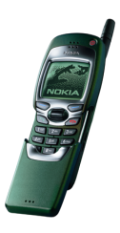
Mobile IPv6 protocol overview
Home Agent
correspondent node
Local Router
correspondent node
charliep@nokia.com
with binding
Seamless Roaming: Mobile Node appears “always on” home network
Routing Prefix from local Router Advertisement
Address autoconfiguration → care-of address
Binding Updates → home agent & correspondent nodes
(home address, care-of address, binding lifetime)

Slide 3
Mobile IPv4 protocol overview
Home Agent
correspondent node
Foreign Agent
135.136.137.1
Seamless Roaming: Mobile Node appears “always on” home network
Foreign Agent supplies Care-of Address in Agent Advertisement
Or, MN address allocation → care-of address
Registration Request → home agent
(home address, care-of address, registration lifetime)

Slide 4
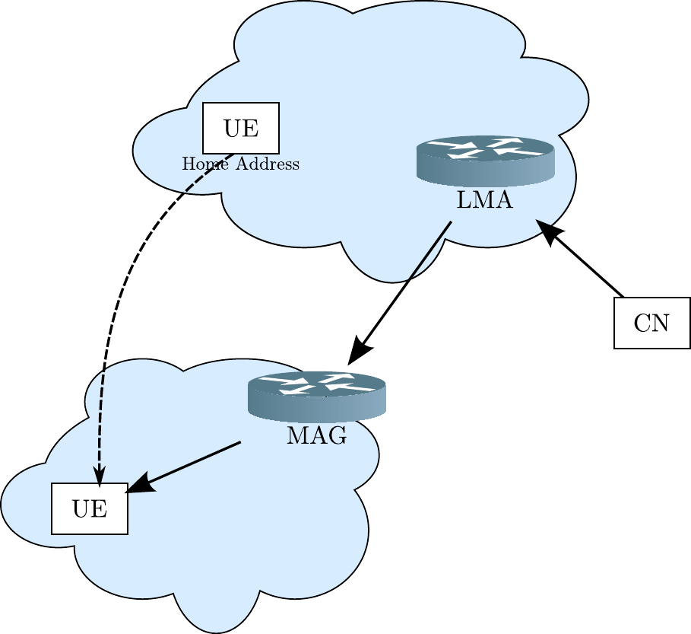
Proxy Mobile IP (PMIP: RFC 5213)
Main idea: run Mobile IP
without requiring any changes
to the mobile node.
Originally envisioned for a
single network domain
UE thinks MAG always has the same
CoA and even MAC address
LMA: the home agent
MAG: the foreign agent
UE: the mobile node
CN: the correspondent node

Slide 5
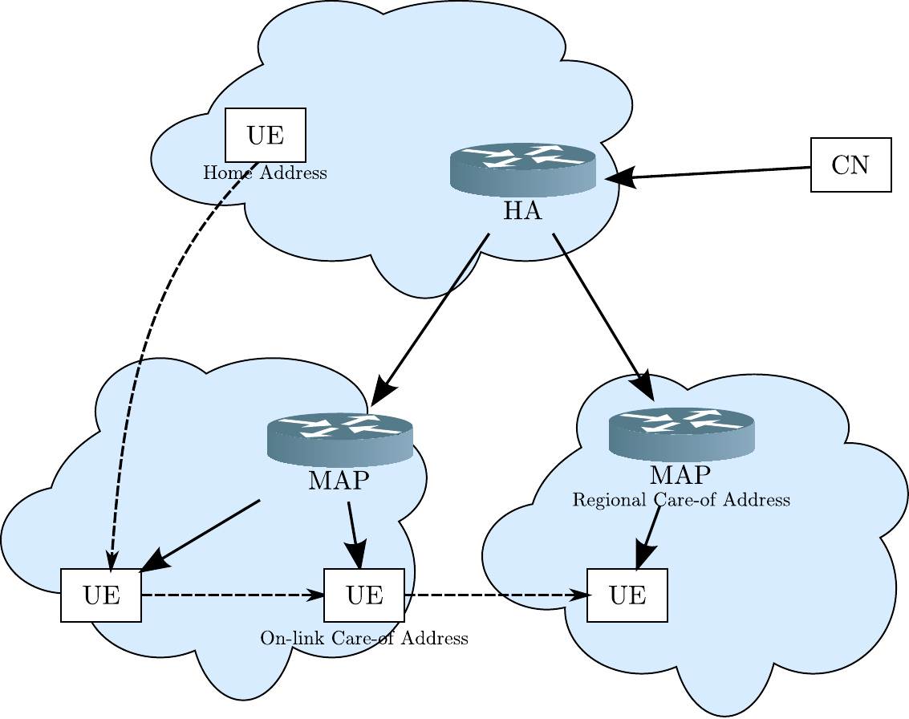
Hierarchical Mobile IP (HMIP: RFC 5380)
Main idea: hide local
movement in MAP domain
UE: the mobile node
MAP: Mobility Access Point

Slide 6

FMIP (RFC 5568): Smooth/Fast/Seamless Handover
Smooth handover == low loss
Fast handover == low delay [30 ms?]
Can router pre-empt Duplicate Address Detection??
Seamless handover:
Fast [localized context transfer via HI and HAck]
Smooth [buffering]
NAR
PAR

Slide 7
FMC terminology
“Fixed”
Fixed means that the access network is DSL
Or, maybe femtocell
Device is not really “fixed” at all!
“Mobile”
A UE (a device managed by a 3GPP network operator)
“Convergence”
Extend 3GPP policy requirements to WLAN e.g.
Fixed Mobile Convergence
Mostly, bringing BBF into 3GPP compliance
But, described as a way of extending user experience
But, all the changes are on the BBF side

Slide 8
Why FMC?
Mobile applications demand more and more bandwidth;
Cellular network becoming the bottle-neck
Cellular network operators want to offload the data traffic to the fixed broadband (FBB) network via WLAN/Home (e)NodeB access;
Operators must employ mechanisms to manage the subscriber’s service over both mobile and FBB network, that is FMC.
FMC based on subscribers’ and operators’ requirements.

Slide 9
Architecture of FMC
Mobile Network
Operator Service
PCRF
UE
eNB
SGW
PDN GW
M AAA
ePDG
Internet Service
Fixed Network
BPCF
F AAA
Femto
BNG
UE
WiFi AP
RG
AN
The fixed broadband network must partner with the mobile network to perform AAA and acquire the policies for the mobile subscriber.

Slide 10
Key issues in FMC
UE identification in FBB network
Femto Access Point (FAP) Management
Device type identification
Carrier Grade NAT (CGN) related issues
UE mobility in FBB network
Flow mobility between different interfaces

Slide 11
Issue 1: UE identification FBB network
Mobile Network
Mobile UE with mobile-routed traffic and no NAT in RG
Mobile UE with mobile-routed traffic with NAT in RG
Mobile UE with offloaded traffic and no NAT in RG
Mobile UE with offloaded traffic with NAT in RG
Operator Service
SGW
PDN GW
Internet Service
Fixed Network
UE
RG
BNG
UE
RG NAT
Key requirements:
In FMC scenario, the policy control must be based on per-UE granularity.
Efficient packet inspection deployment
Issue: Limitations with BNG implementations for per-UE granularity enforcement due to address sharing with NAT in RG, in case 2 and 4.

Slide 12
Issue 2: Femtocell AP Management
Inner IP assigned by Mobile Network
BPCF
PCRF
MME/SGW
FAP
RG
BNG
SeGW
FAP-GW
UE
Private IP
Public
IP +Port
(NAPT)
PGW
IPSec Tunnel
Fixed Network
Mobile Network
MME Mobility Management Entity
Internet Service
Key requirements:
Inter-operators subscribers policy exchange (the private and public addressing which rely on NA(P)T, must be coordinated cross operators);
Femtocell AP must be identified for management.
Issues:
Binding the port number after NA(P)T for special Femtocell AP is needed;
Binding the FAP’s Public IPv4 address and the UE’s inner-IPv4 address is needed.

Slide 13
Issue 3: Device type identification
Key requirements:
Only special traffic from special devices, such as mobile phone, need policy control and management. For example, 3GPP service from mobile phone.
Issue:
In the current WiFi network, the device type information is transparent to the fixed broadband network, because only IP and port information is used for identification.

Slide 14
Issue 4: CGN related issues
Requirements:
Long lived IPsec or TLS connection across Carrier Grade NAT (CGN) can not be flushed.
Issues:
Currently most NAT implementations would flush all sessions after they reach 24 hours, regardless of the state of the session.
The session flush will cause more attachment signaling to be introduced in order to re-establish UE’s sessions.

Slide 15
Issue 5: UE mobility in FBB network
Policy for UE identified by IP+Port
BPCF
PCRF
MME
Private IP1
UE1
RG
BNG
ePDG
SGW
UE2
Private IP2
Public IP
(NAPT)
PGW
We divide the mobility capability into two cases:
UE is moving into or outside the coverage area of WiFi AP
UE’s WiFi access is dormant or not
Fixed Network
Mobile Network
Internet Service
Requirements:
The UE identification must be consistent between the FBB network and the mobile network for policy exchange, even when UE is moving.
Issues:
Because plenty of UEs are in AP coverage at different time slot , it is possible that the same UDP port will be used for different UEs. If the UE identification can not be updated in time based on the status, the PCRF will be confused about which policy is used.

Slide 16
Issue 6: Flow mobility between different interfaces
Requirements:
Traffic offloading requires the ability to move the traffic flows from one interface to the other interface of the UE.
The type of flows to be moved depends on the policy and should be dictated by the mobile operators.
Issues:
No flow mobility protocol has been applied for offload traffic.

